Slide 1
CS CM122 Discussion
Apr 21 2023

Slide 2
Overview for today
Part 1. Textbook chapter 8
Part 2. Answering questions on project 1

Slide 3
Chapter 8

Slide 4
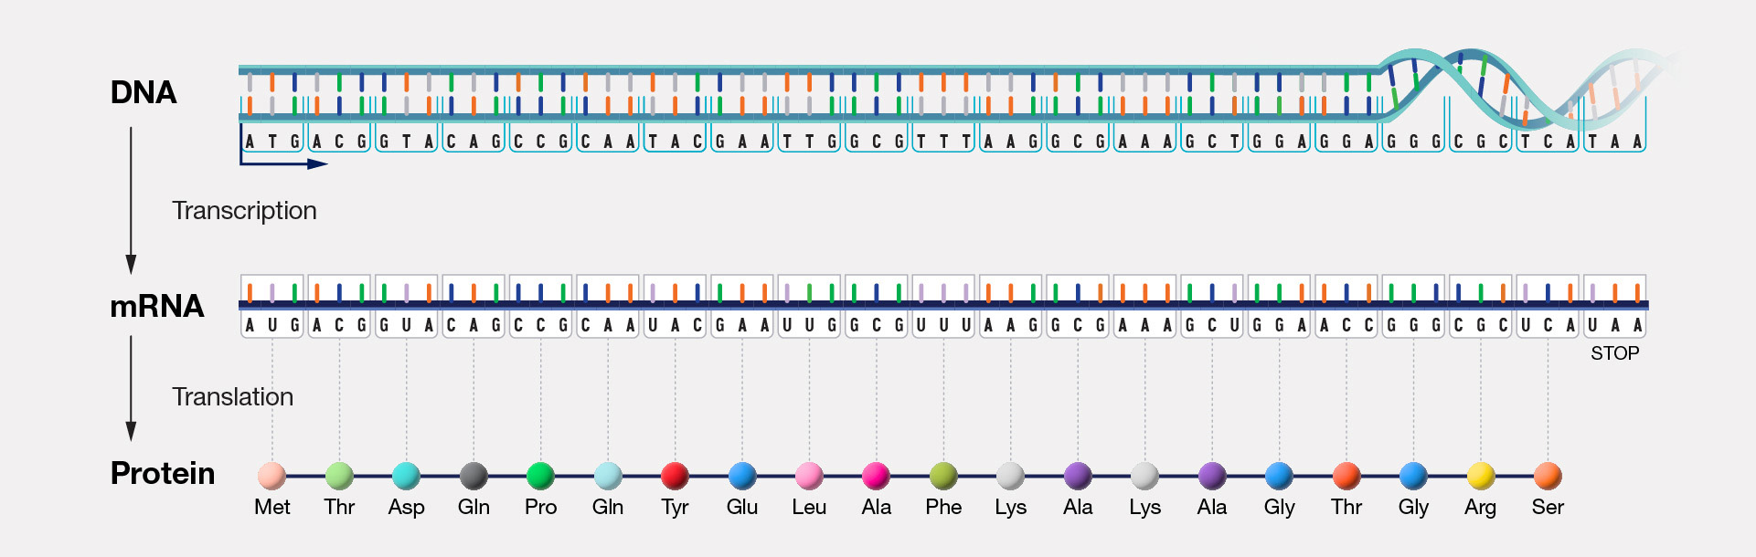
Background: central dogma of molecular biology
https://www.genome.gov/genetics-glossary/Central-Dogma
Some segments of the DNA are protein-coding genes. Gene expression is the process where the gene’s DNA is transcribed into mRNA, which is then translated into a protein that performs certain biological functions.
One way to measure gene expression is through counting the mRNAs.

Slide 5
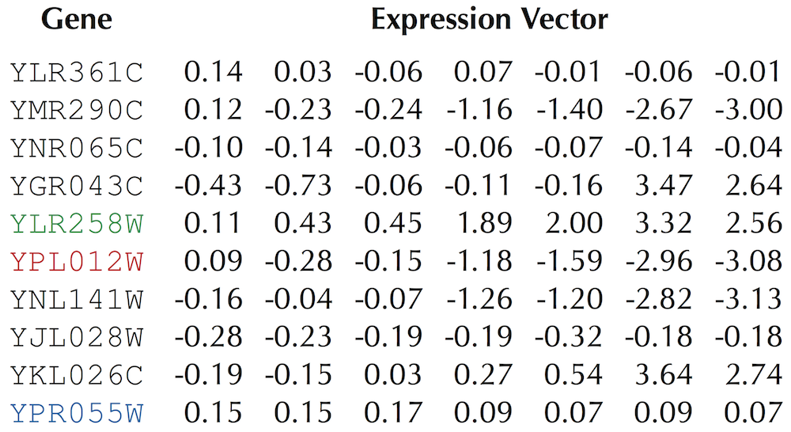
Gene expression matrix
Question: can you identify groups by just looking at this matrix?
Textbook 8.3
Each row is a gene and each column is an experimental condition (e.g. different time points)
The goal is to find groups of genes with similar behavioral patterns across conditions.

Slide 6
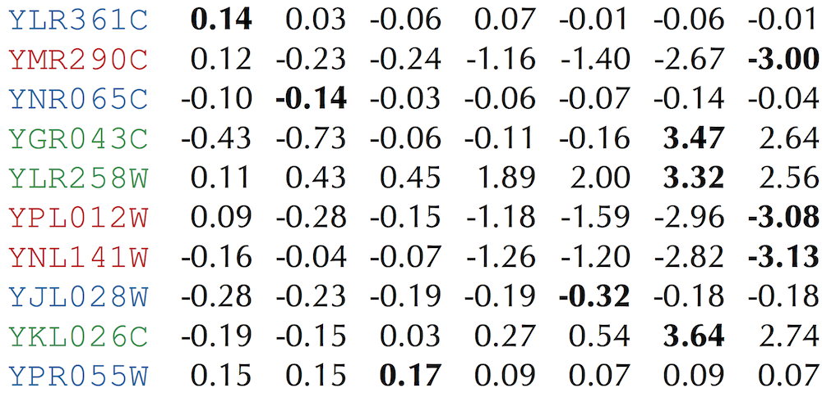
Gene expression matrix
Textbook 8.3
Blue genes remain static. Red genes show decreasing expression. Green genes show increasing expression.

Slide 7
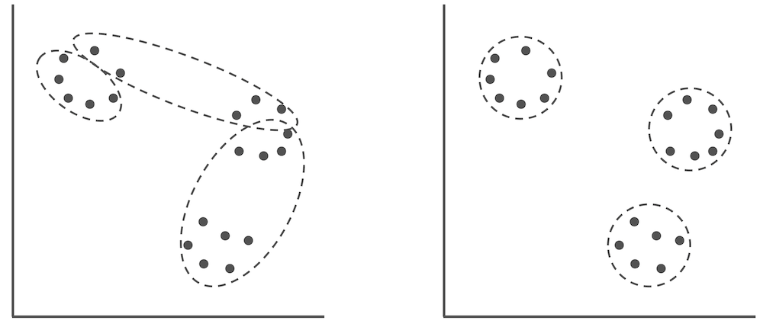
Clustering
The high level idea of clustering is to assign N points into k clusters, where points in the same cluster are “similar” to each other compared to points in other clusters.
“Not good”
“Good”
Textbook 8.4
Notes:
Answer:

Slide 8
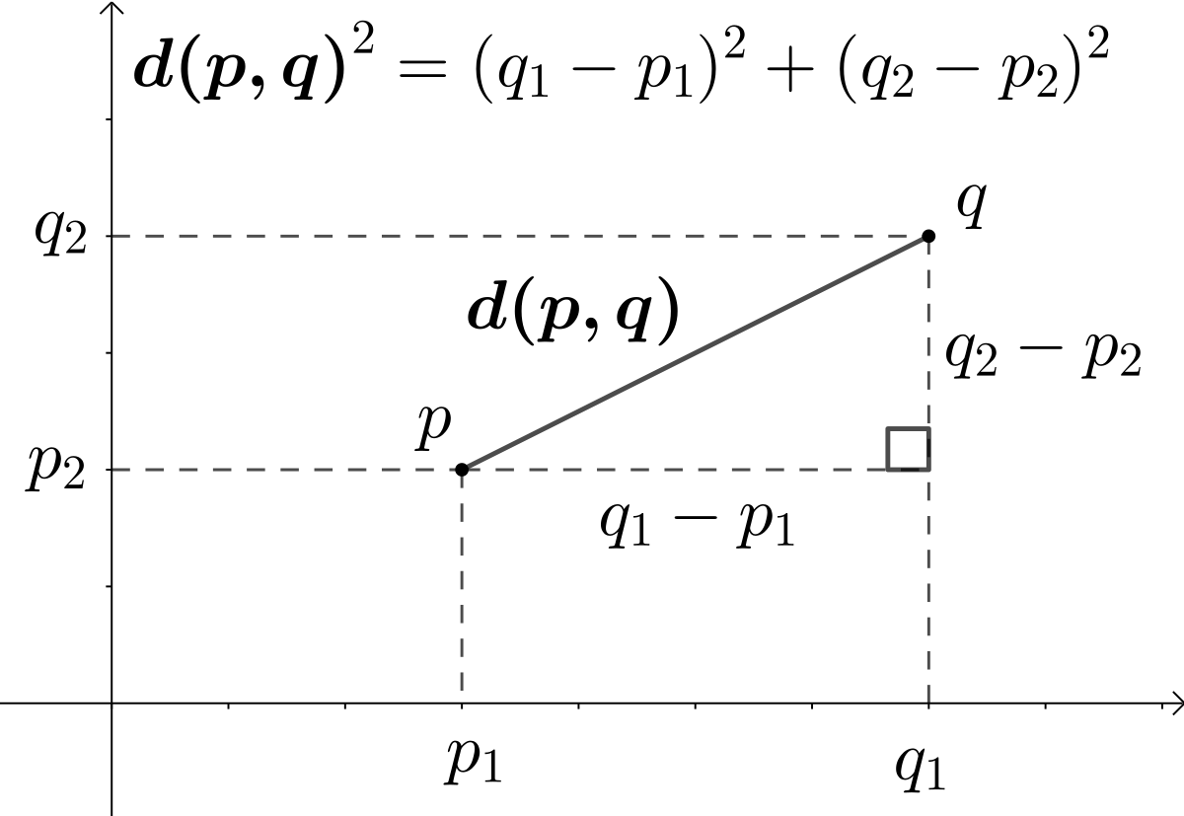
Defining “similarity” between points
Wikipedia
One way to define “similarity” is to take the Euclidean distance between two points, that is the length of the line segment connecting the two points.

Slide 9
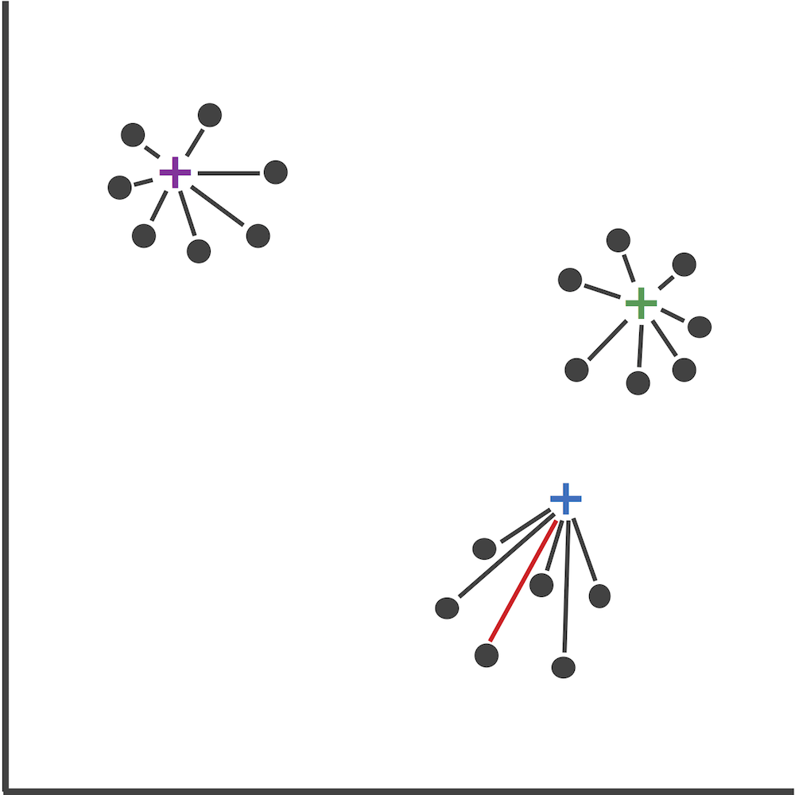
K-centers clustering
The goal is to find a clustering configuration such that the “longest distance from any point to its nearest center” (the red line) is as small as possible.
You can think of it as trying to build k hospitals among N towns while ensuring each town is not too far away from its nearest hospital
Textbook 8.5

Slide 10
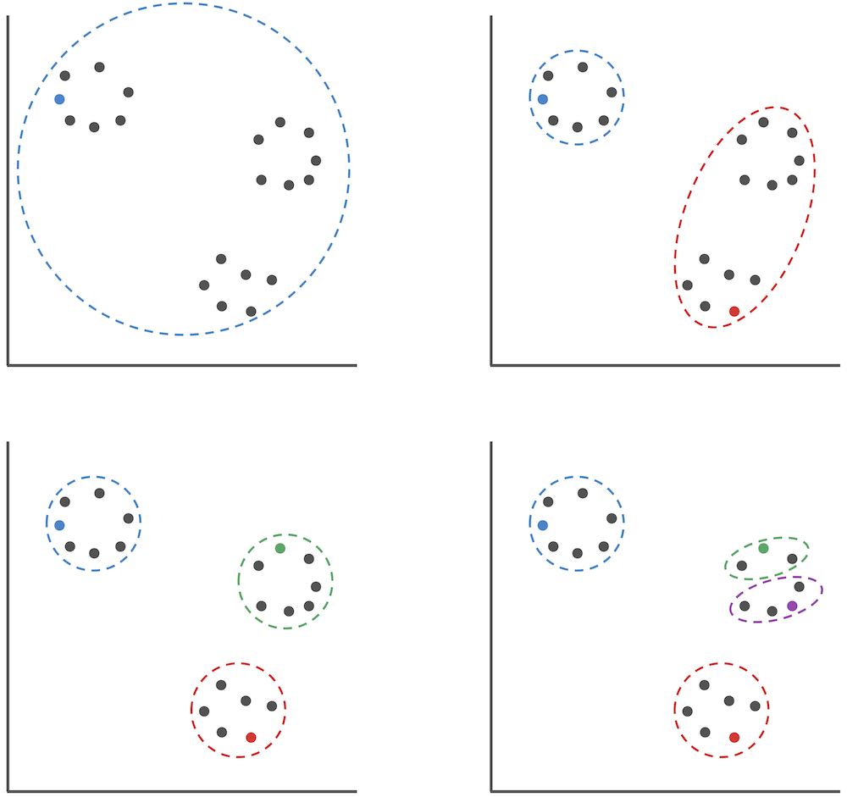
K-centers clustering using farthest first traversal
Step 1: Randomly select a point to be the first center. Assign every point to this center
Step 2: Find the point with the longest distance to its center
Step 3: Make this point the second center. Assign every point to their nearest center
Step 4: Repeat steps 2-3 until you have found k centers
Textbook 8.6

Slide 11
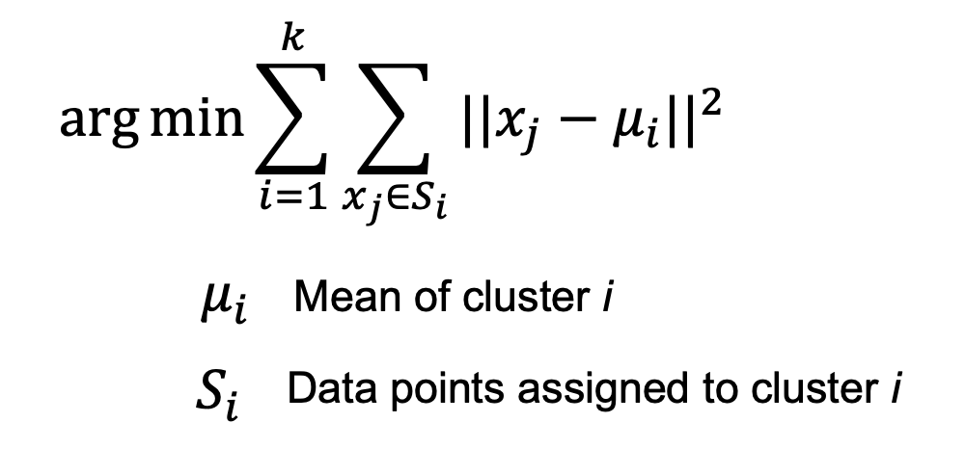
K-means clustering
The goal is to find a clustering configuration such that the sum of distances between each point to its assigned center is the smallest

Slide 12
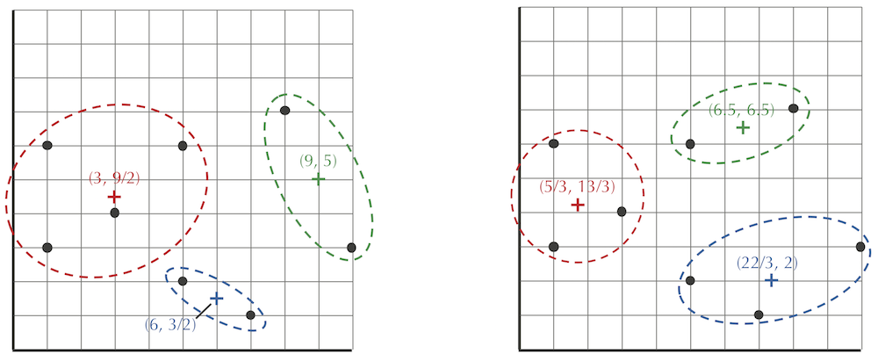
K-centers vs. K-means
K-centers
K-means
Textbook 8.7

Slide 13
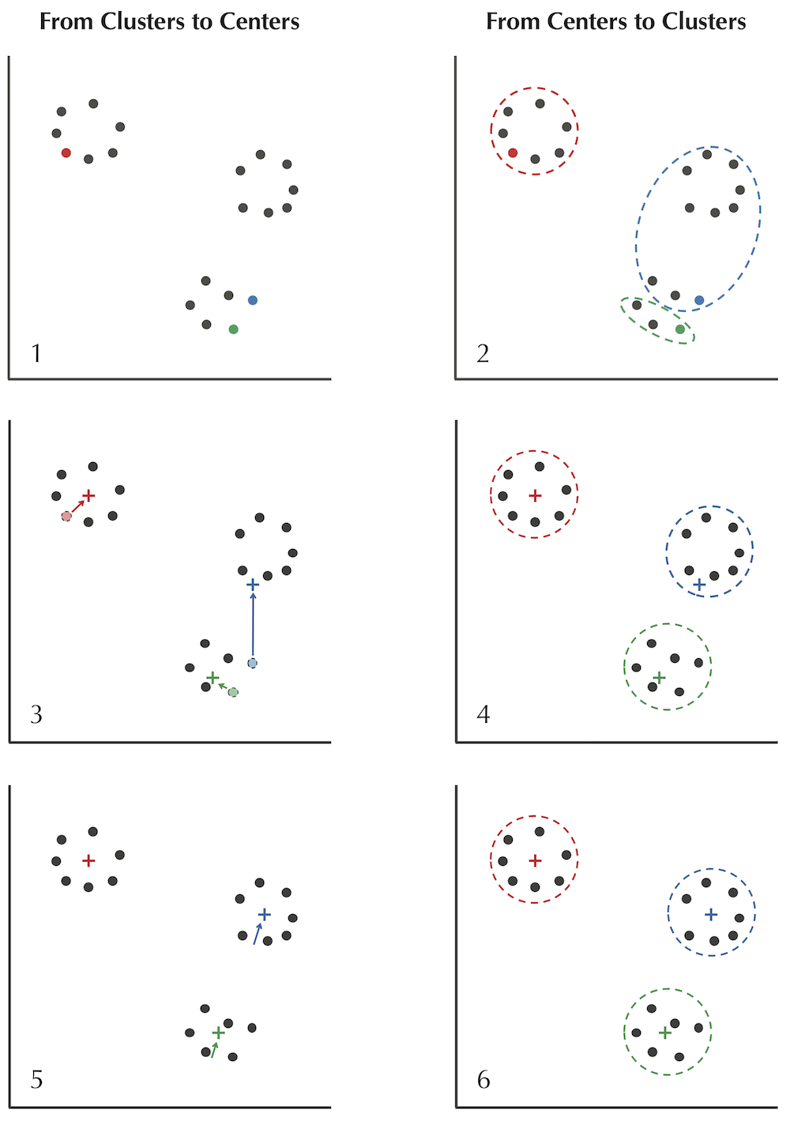
The Lloyd algorithm
First randomly select k points as centers. Repeatedly:
Centers to Clusters: assign each data point to the cluster corresponding to its nearest center
Clusters to Centers: assign each cluster’s center of gravity/centroid (average coordinate of all points) to be the cluster’s new center.
Textbook 8.7

Slide 14
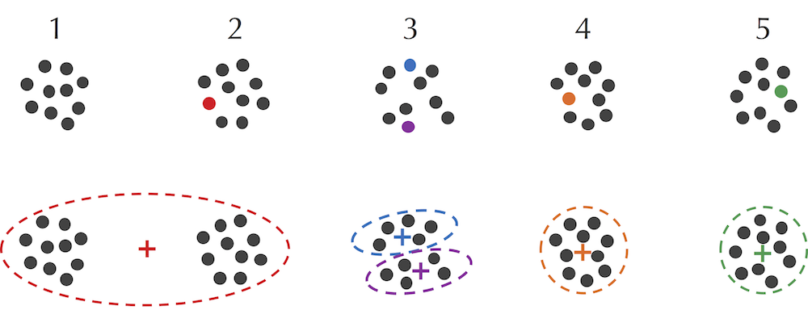
Initialization of K-means
Textbook 8.8

Slide 15
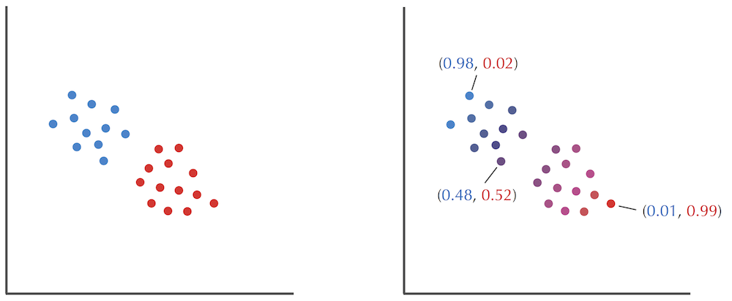
Soft clustering
Textbook 8.10
Sometimes you want soft assignments (probability of each point belonging to each cluster)

Slide 16
Hard vs. soft clustering
 | K-means | Soft clustering
How are points assigned to centers | Each point is assigned to the nearest center | Points are not assigned to single enters. Instead each point has a “weight” for each cluster
How are “clusters” defined | Each cluster is a set of points. Clusters are non-overlapping. The center of the cluster is the centroid of all points assigned to the cluter | Clusters can be sets of points, but can also be parametrically defined by distributions

Slide 17
In-class whiteboard demonstration: the expectation-maximization algorithm
- 5 points on a 1-D space
- 2 normal distributions with unit variance and uniform prior

Slide 18
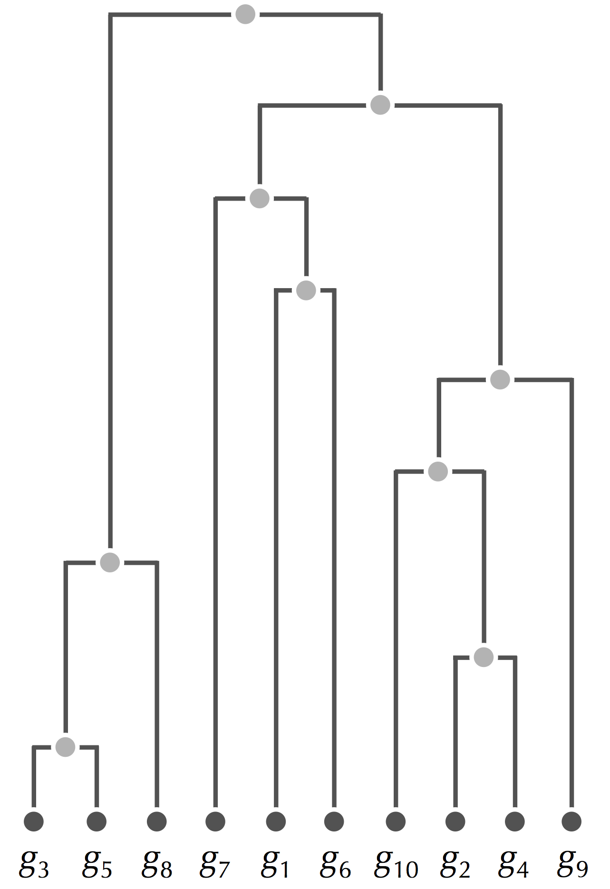
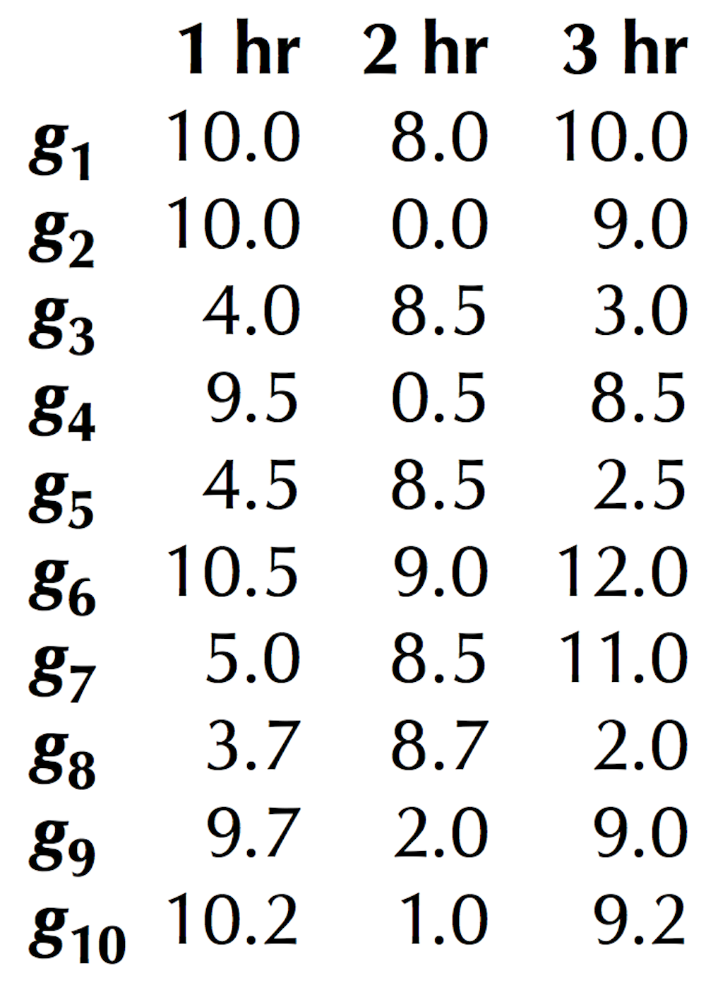
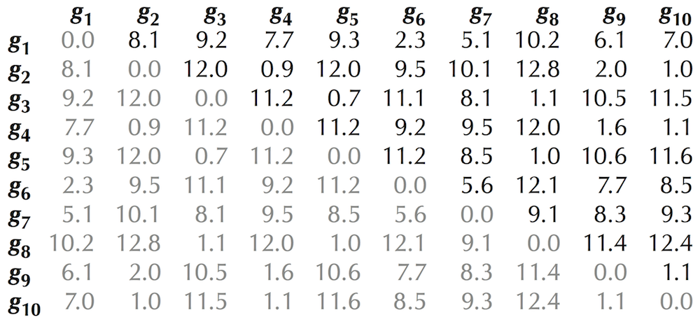
Hierarchical clustering
Pairwise distances between points
Points
Dendrogram of points
with heights corresponding to pairwise distances

Slide 19
Hierarchical clustering
First assign each point to its unique cluster. Repeatedly:
- Compute the distance* between each pair of clusters
- Find the two clusters with the smallest distance to each other
- Merge these two clusters
Question: how to define distance between two clusters (each cluster may have multiple points)?

Slide 20
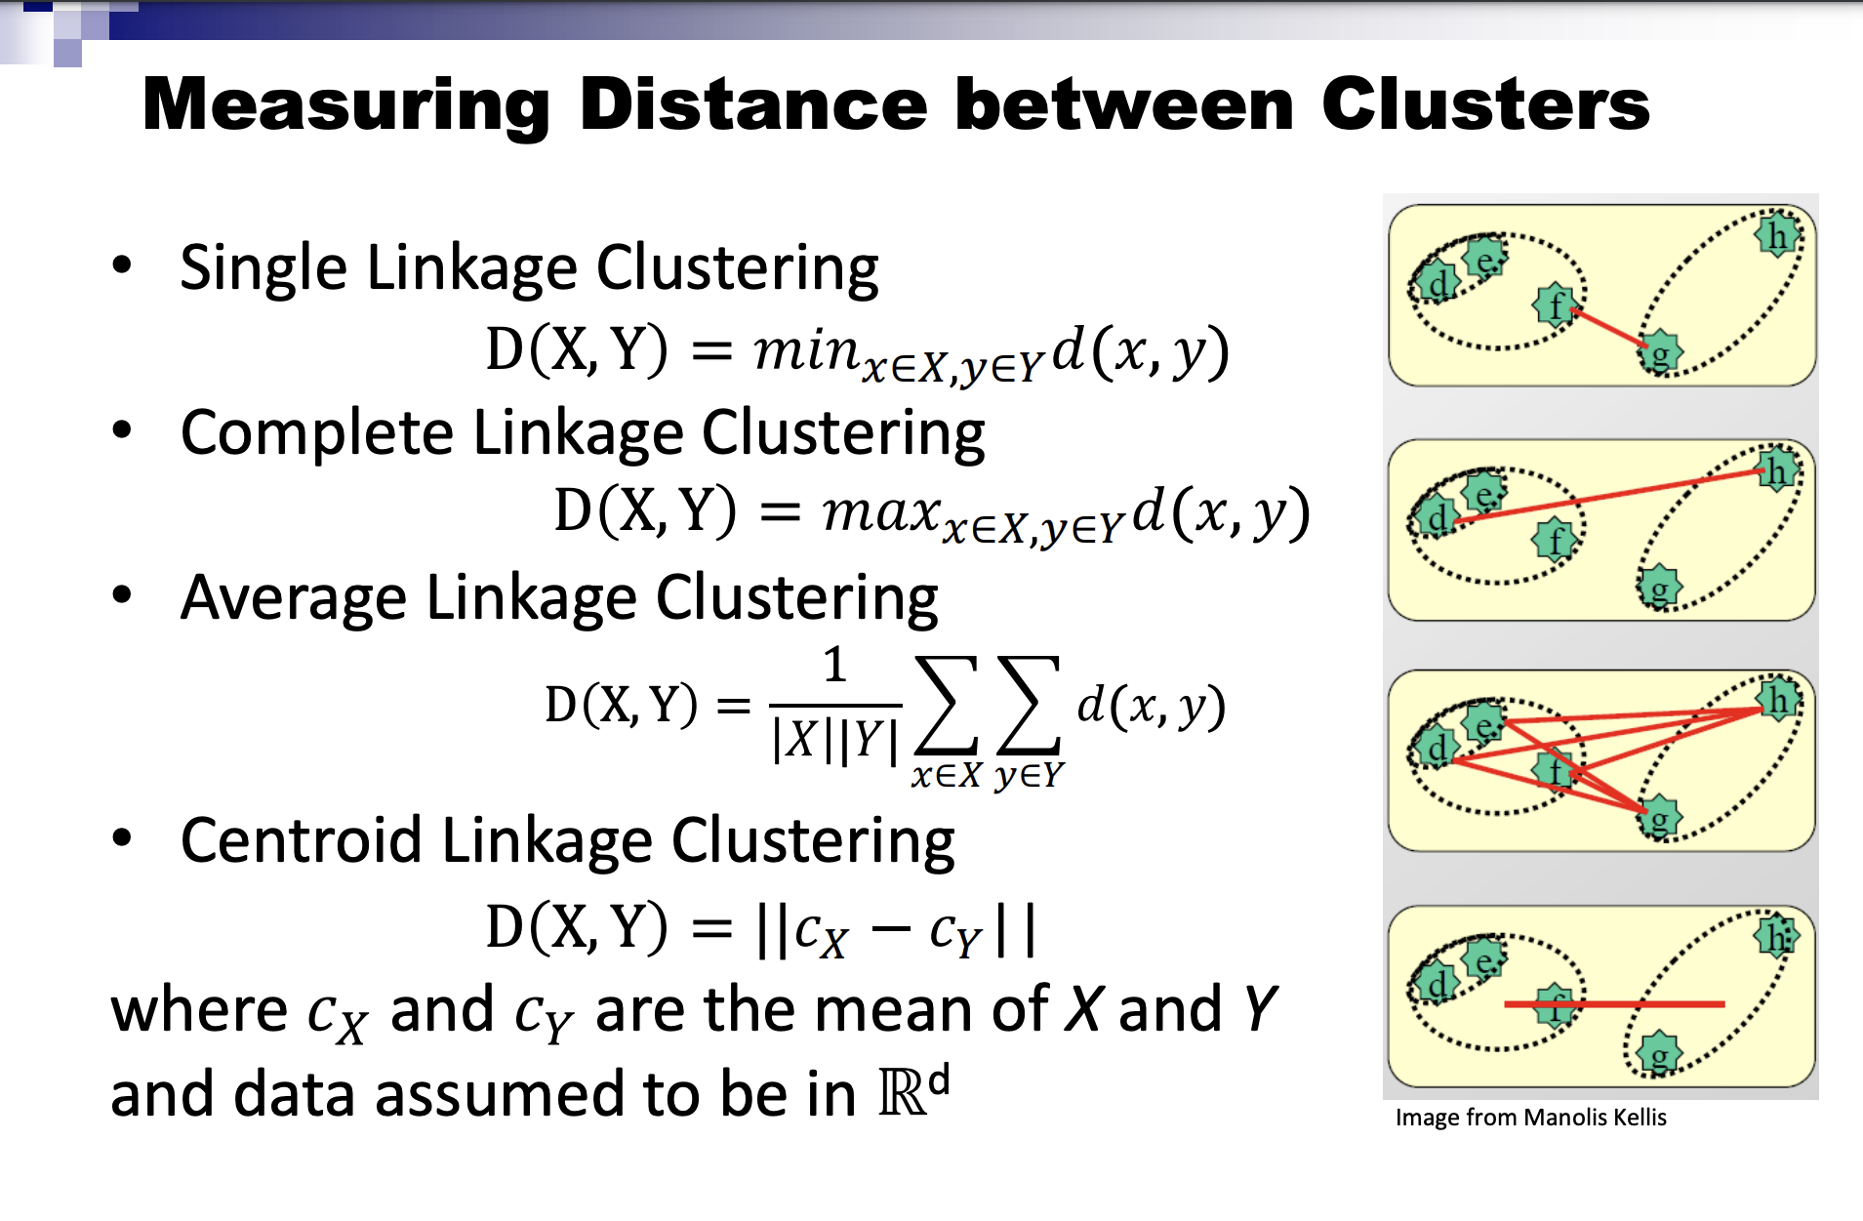
Hierarchical clustering distances
Lecture 4

Slide 21
Questions on project 1a

